Slide 1
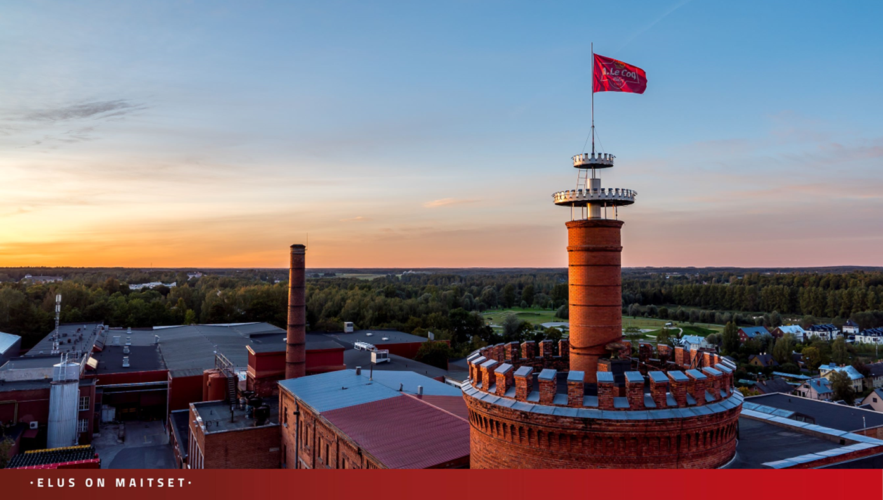


Sustainability in
A. Le Coq
Hanna Uibokand
ESG specialist
22.03.2024

Slide 2

The jury praised our dedication to sustainability and social responsibility:
  well-thought-out actions in promoting sustainable development
  your perception of social responsibility,
  your care for the community.
  “Thank you for being an example to other companies taking steps towards more sustainable practices!”

Slide 3


Slide 4
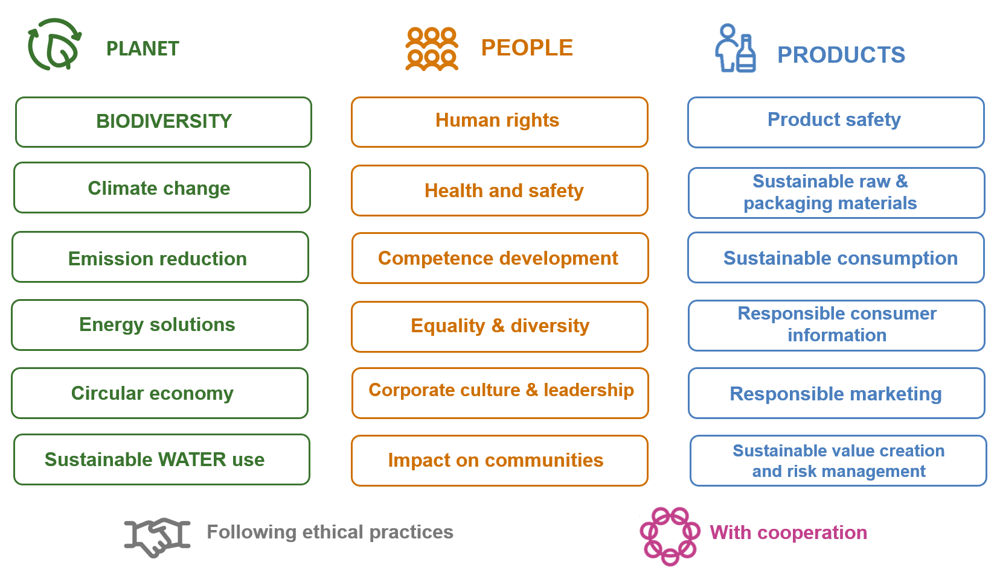

Slide 5
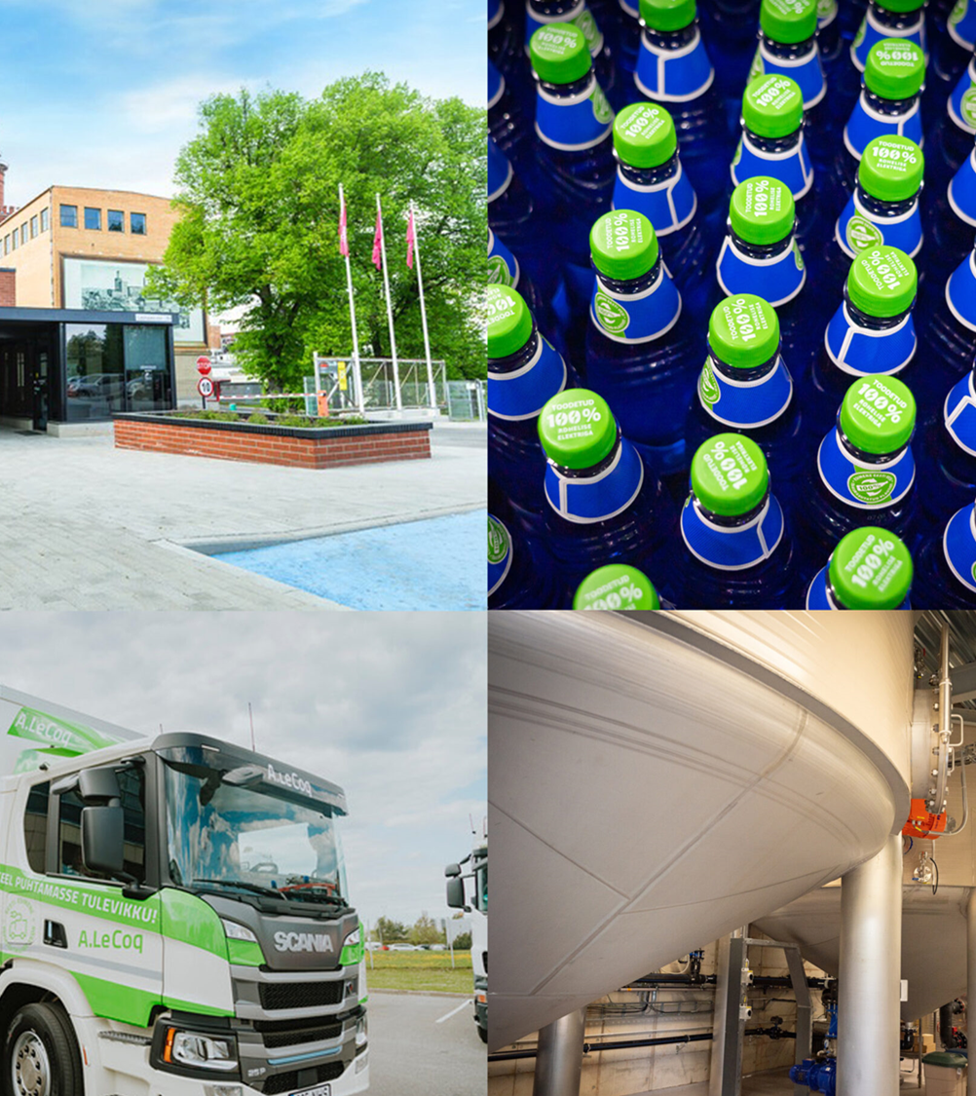
Green electricity
Wastewater treatment enables the production of biogas from its wastewater
Electric trucks
Solar parks
Heat energy collection for re-use in the production

Slide 6
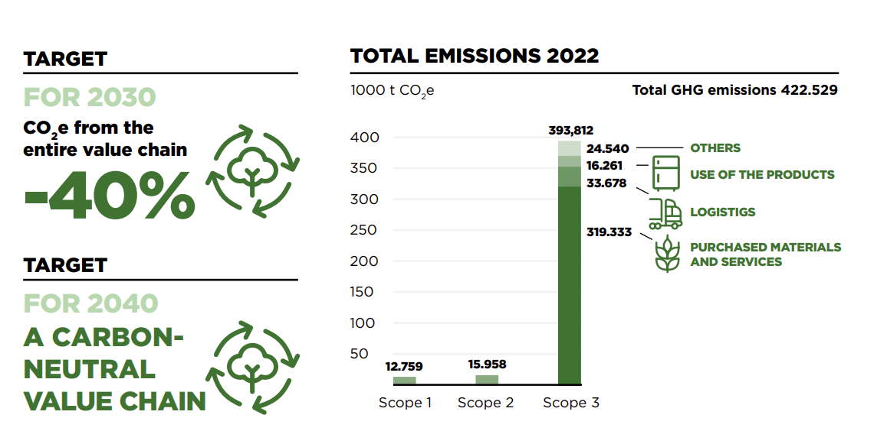

Slide 7
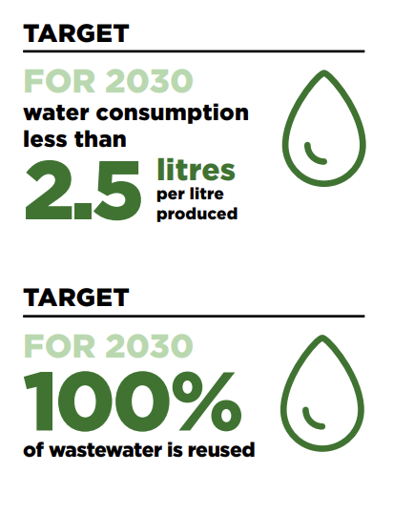
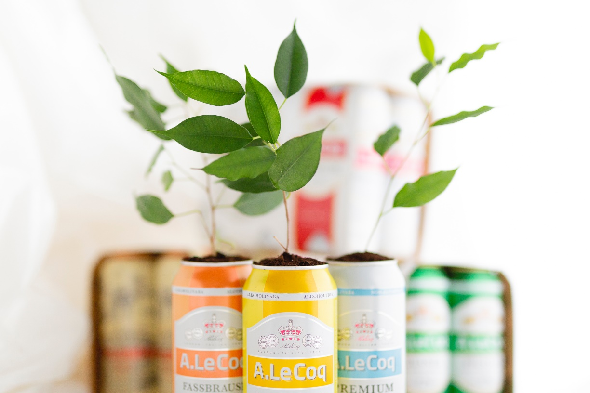
SUSTAINABLE WATER USE

Slide 8
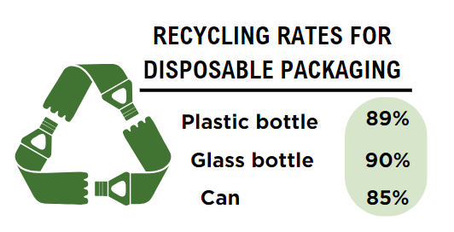
PROMOTING THE CIRCULAR ECONOMY
All our packaging is recyclable or refillable
We optimise the use of the material in packaging
96,9% recycling and reuse of waste and materials
Recycled plastic used in Aura pet-bottles
Cardboard multipacks from recycled fibres
Spent grain and yeast circulation

Slide 9
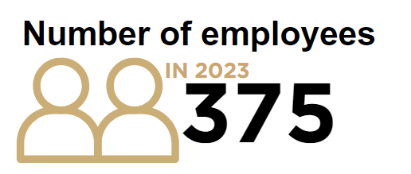
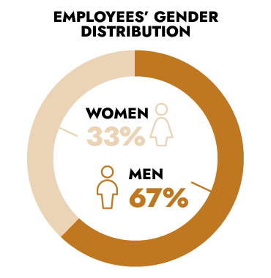
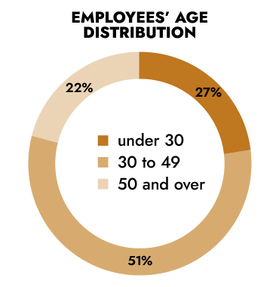


Slide 10
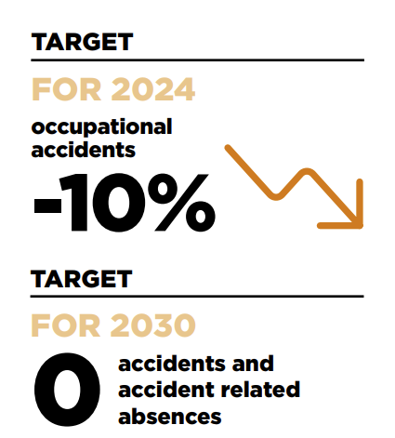



Slide 11
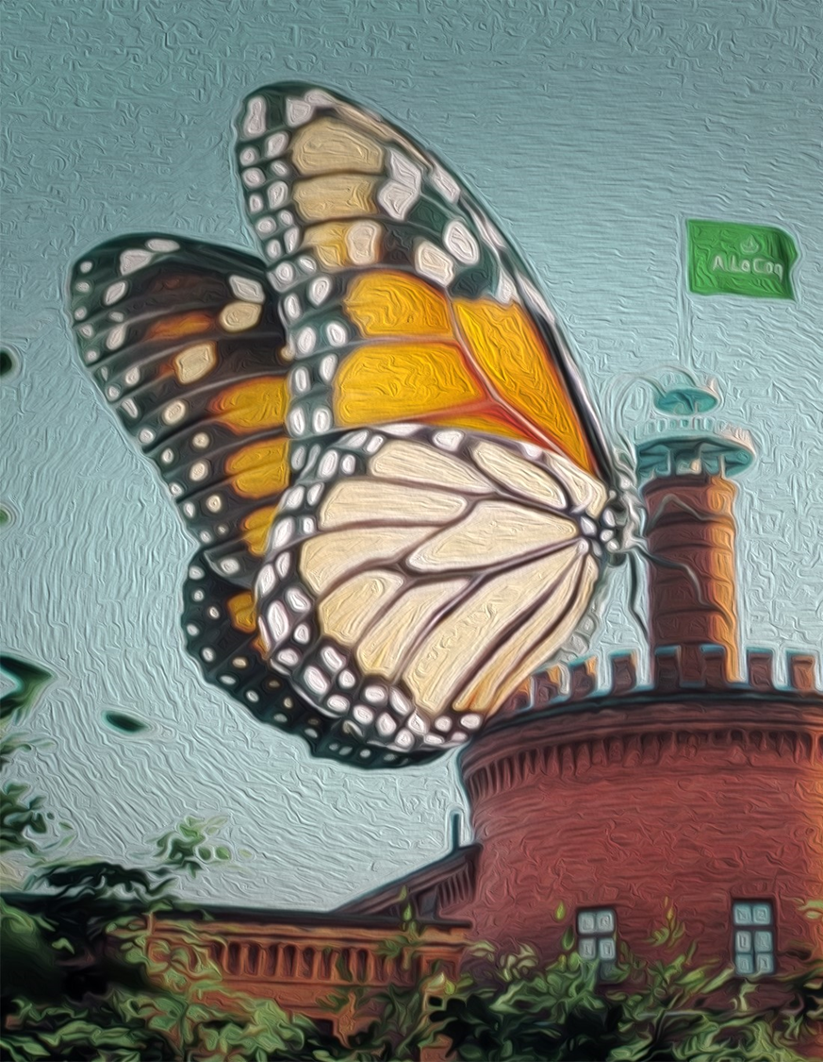
Well-being of communities
A Brewery museum, nominated for the Best Permanent Exhibition in 2022
Collaboration with the Estonian Football Association since 2002
Scholarships in the field of technology every year
Honoured supporter of defenders of the state
The main supporter of the European Capital of Culture Y2024

Slide 12

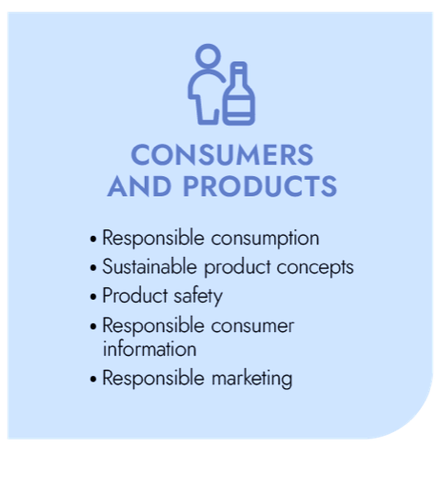


Slide 13
